Slide 1
Mere
Desh
Ki
Dharti

Slide 2
Agriculture
Technology
AGRICTECH
Agriculture is the future
&
we are innovating it..

Slide 3
INNOVATIONS
Water Level Adjuster

Slide 4
INNOVATIONS
Water Level Adjuster
Mobile Application

Slide 5
INNOVATIONS
Water Level Adjuster
Mobile Application
Sensors

Slide 6
Water Level Adjuster
Parameters:-
Soil Type
Season
Crop Type
Area Of Field

Slide 7
Water Level Adjuster
Parameters-
Soil Type
Season
Crop Type
Area Of Field
Based on this parameters we will analyze how much water is needed for a crop to give better yield.
This will drastically reduce wastage of water.

Slide 8
Water Level Adjuster
We will set a device near tubewell which will be operated by Solar energy & based on need of water it will automatically switch on water supply to the crops .

Slide 9
Water Level Adjuster
We will set a device near tubewell which will be operated by Solar energy & based on need of water it will automatically switch on water supply to the crops .
As it is based on solar energy so we can also manage problem of electricity by running it only for remaining time.

Slide 10
Vertical Farming

Slide 11
Vertical Farming
Growing Crops inside farms means controlled environments or
we can say artificial environment which will remove dependency
of production from weather and maximize the production
per square foot.

Slide 12
Mobile App
App includes direct connection of the consumer to the farm by which the consumer can get notified about the crops.
Stats of Crops going on ...
Farmer will login and will select season , soil and crop then according to the current situation all fertilizers and seed at minimal cost will be displayed in screen...

Slide 13
Mobile App
Farmer will be notified if any problem will arise during the germination of crops.
If there will be any chance of disruption in crops then in the app with proper insecticide and fertilizer, the farmer will be informed.
When crops are ready to cultivate, in which time of span the price of crop is higher in market all this thing will be notified by app.

Slide 14
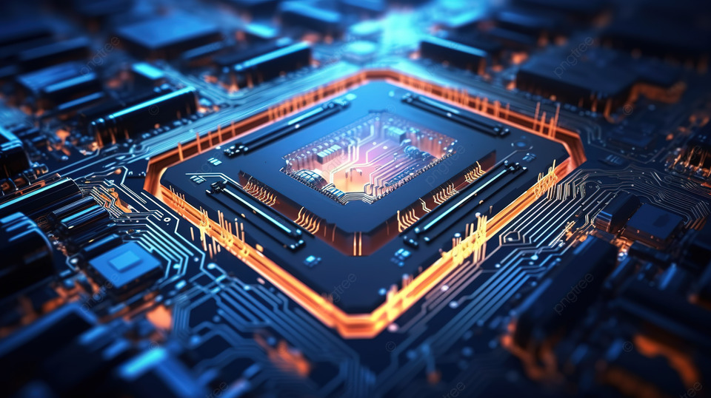
Sensors
Embedding tiny sensors within or around crops will provide real time data on various parameters like nutrients level and hydration and pest presents.
Based on the data that sensors have will give us the condition of plant growth and according to that we will provide specific nutrients.

Slide 15
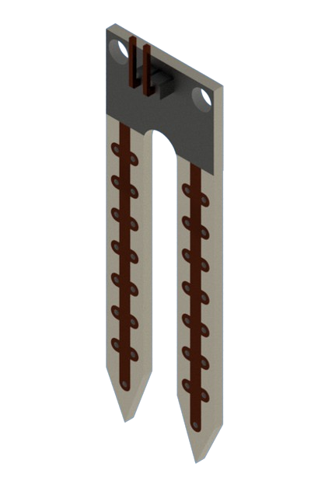
IOT Device & Sensor
Sensors:-
Soil erosion sensors:-
Sensors detecting changes in soil topography or monitoring water flow can help prevent soil erosion and promote sustainable land management practices.

Slide 16
Sensors

Slide 17
Thank you !!

